Slide 1
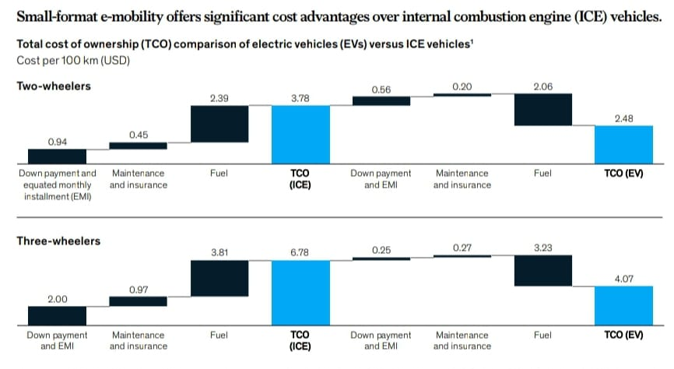
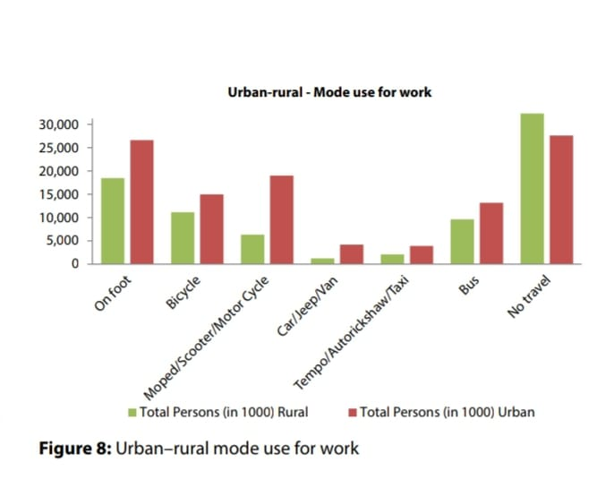
Need for Electric Vehicles
India’s automotive industry is the fourth largest in the world, contributing 7.2% to the Indian gross domestic product (GDP) in 2017.The growing demand for automobiles makes it imperative to counter the negative externalities associated with the transport sector.Electric mobility offers a potential solution to lower emissions and pollution while offering similar level of mobility.
Electric Vehicles (EVs) are almost five times more energy efficient as compared to ICE vehicles.EVs are more reliable than internal combustion engine (ICE) vehicles, as their total cost of ownership (TCO) is lower, given their lower fuel and maintenance costs .They are also less dependent on charging infrastructure, since their power requirements are lower, and they are more likely to come in models that allow battery swapping.
The EVs will provide an indirect push to renewable energy due to the excess energy demand that would be created by the uptake of electric vehicles.
The demand of automobiles for urban and rural work sectors can be seen in this graph:

Slide 2
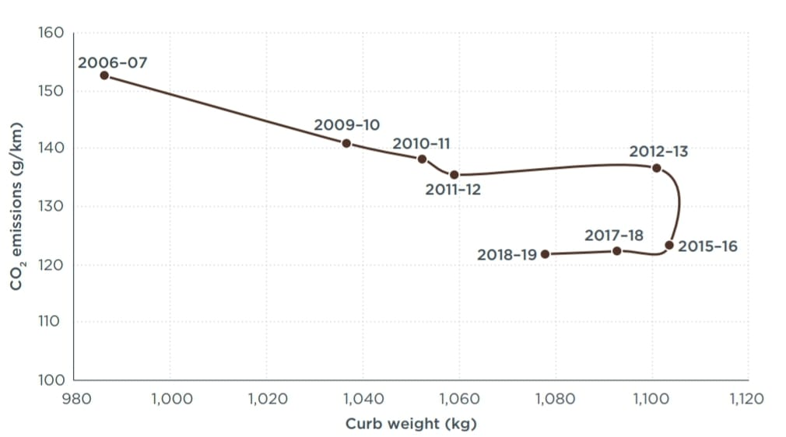
Environmental Impacts
CO2 emissions
Air Pollution
Oil Import
India is already the fourth largest emitter of CO2 (2.5 m kT in 2015).Globally, emissions from road transport contributed around 16% to annual CO2 emissions in 2017.
Vehicle emissions contribute to 20% of PM 2.5 and about 36% of NOx emissions in New Delhi.
India is the third largest importer of crude oil in the world.By 2030, India is expected to spend $550bn on imported fuel for mobility. That is close to one-fourth of its current annual GDP.
SOLUTION
SOLUTION
Reducing tailpipe emissions is
key to a long-term solution for India’s pollution problem
SOLUTION
Due to the high tank-to-wheel efficiency of EVs, overall CO2 emissions per vehicle will decrease by almost 30% when compared to ICEs.
Shifting to electric vehicles (EVs) would reduce India’s dependence on oil imports.
The CO2 emissions in India can be viewed here-

Slide 3
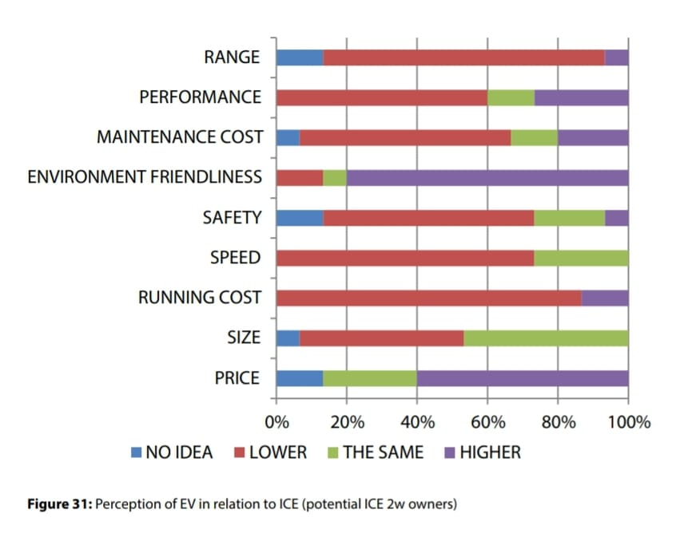
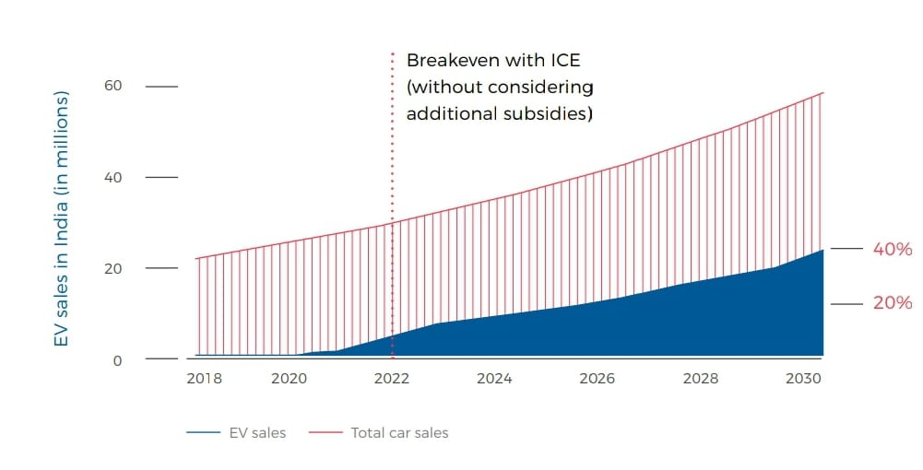
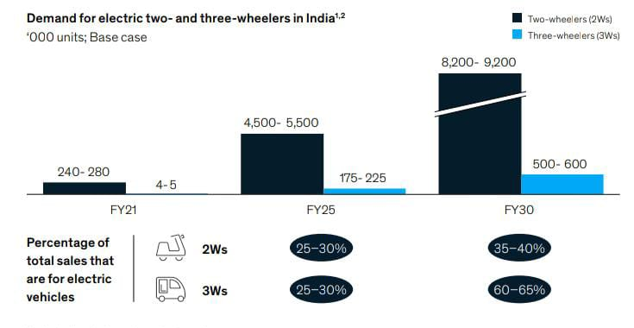
Consumer’s Perspective
By 2030, 40% of new vehicles sold in India (24 million) could be battery powered because of the consumer demand. The number of EVs sold in India in 2030 would thus surpass the total number of vehicles sold in India in 2016, which was 22 million.Demand for small format e-mobility could rise to about 9 million units by fiscal year 2030.
Across use cases, more consumers are willing to go for EVs over ICE vehicles. According to McKinsey’s 2019 Autonomous, Connectivity, Electrification, and Shared mobility (ACES) survey, one major problem is the safety of EVs. This was the top concern of consumers after TCO and the availability of charging infrastructure.
According to a survey conducted by TERI- The perception of EV in relation to ICE can be seen like this :
A prediction of the EV sales in India and its demand can be seen like this:

Slide 4
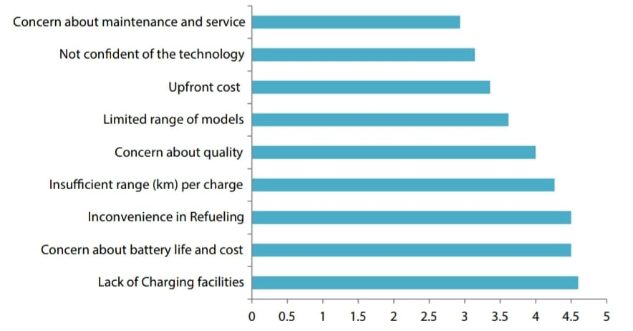
Problems Faced
The shift to EVs would mean the new vehicles in India would be powered by electricity rather than fossil fuels which in turn would need that many batteries.Also if the source of the power of the electric vehicles itself continues to be fossil fuels rather than renewable power, it would defeat the purpose of EVs.
The paradigm shift from combustion engine to battery, motor, controller, and charger will challenge the highly evolved Indian automobile industry as 50% of the revenue of the automobile industry comes from engine manufacturing.
Electric vehicles use lithium batteries.In India, lithium batteries are only assembled, not manufactured. This will also cause a major problem in mass production of EVs.
Battery usage is very essential, so if reusable batteries will not be made for such a huge amount of vehicles then the GHG footprint will not have a significant decrease.
According to a survey conducted by TERI, the concerns of the consumers were-

Slide 5
Government’s Initiatives
In October 2020, while speaking at the India Energy Forum, PM Modi said that - increasing the contribution of electricity to decarbonise mobility and achieving the renewables target of 450 gigawatts as one of the seven key drivers of India’s energy map.
Several Policies implemented by the Government towards this Electrification are-
Alternate Fuels for Surface Transportation (AFST) Programme
National Electric Mobility Mission Plan (NEMMP) 2020
Faster Adoption and Manufacturing of (Hybrid &) Electric Vehicles (FAME - India), 2015 Phase 1
Faster Adoption and Manufacturing of (Hybrid &) Electric Vehicles (FAME - India), 2019 Phase 2
National Energy Storage Mission, 2018
National Policy on Electronics, 2019

Slide 6
Conclusion
In future, Industries will be driven by ACES (Autonomous driving, Connectivity, Electrification, and Shared mobility).
Therefore, Electric Vehicles are very much potentially capable of shaping the future of India in terms of economy as it will present an opportunity for Indian manufacturers to leapfrog to the technological forefront of car manufacturing. This would create a large, highly-skilled and sustainable pool of Indian jobs, growth, and sustainable development.
There are many benefits of adopting electric vehicles such as reduced dependence on imports of crude oil, and reduction on greenhouse gas emissions and air pollution
FUTURE OF EVs - 4 levers
Autonomous
Driving
Electrified and shared autonomous vehicles or better known as robo-taxis and shuttles, make mobility in urban places more efficient, affordable, safe, environment, and user friendly.
Unlike the mixed signals that autonomous driving received, e-vehicles have gained momentum through huge contributors like the tightening of environmental regulations and the growing customer demand.
Electrification
The response to high congestion in metropolitan cities like Bengaluru, Delhi, Mumbai has led to the popularity of several ride-hailing services. The two largest cab aggregators show their presence in over 250 cities with ~36 lakh trips booked daily.
To develop this aspect of technology, most certainly it would require a variety of different partners all having expertise that would make up the unique user interface and AI required.
Shared Mobility
Connectivity

